Slide 1
realMLS is proud to offer realMAILERS

Slide 2
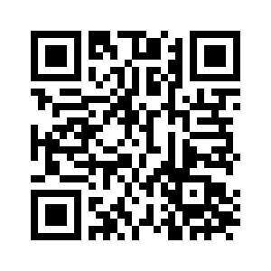
It’s So Easy!
Go to MyMMT.
Search for Properties.
Click Export to realMAILERS and follow the prompts.
Your postcards will be delivered in mailboxes in just a few days!
For more information, scan the QR code for a quick how-to-video!

